Slide 1
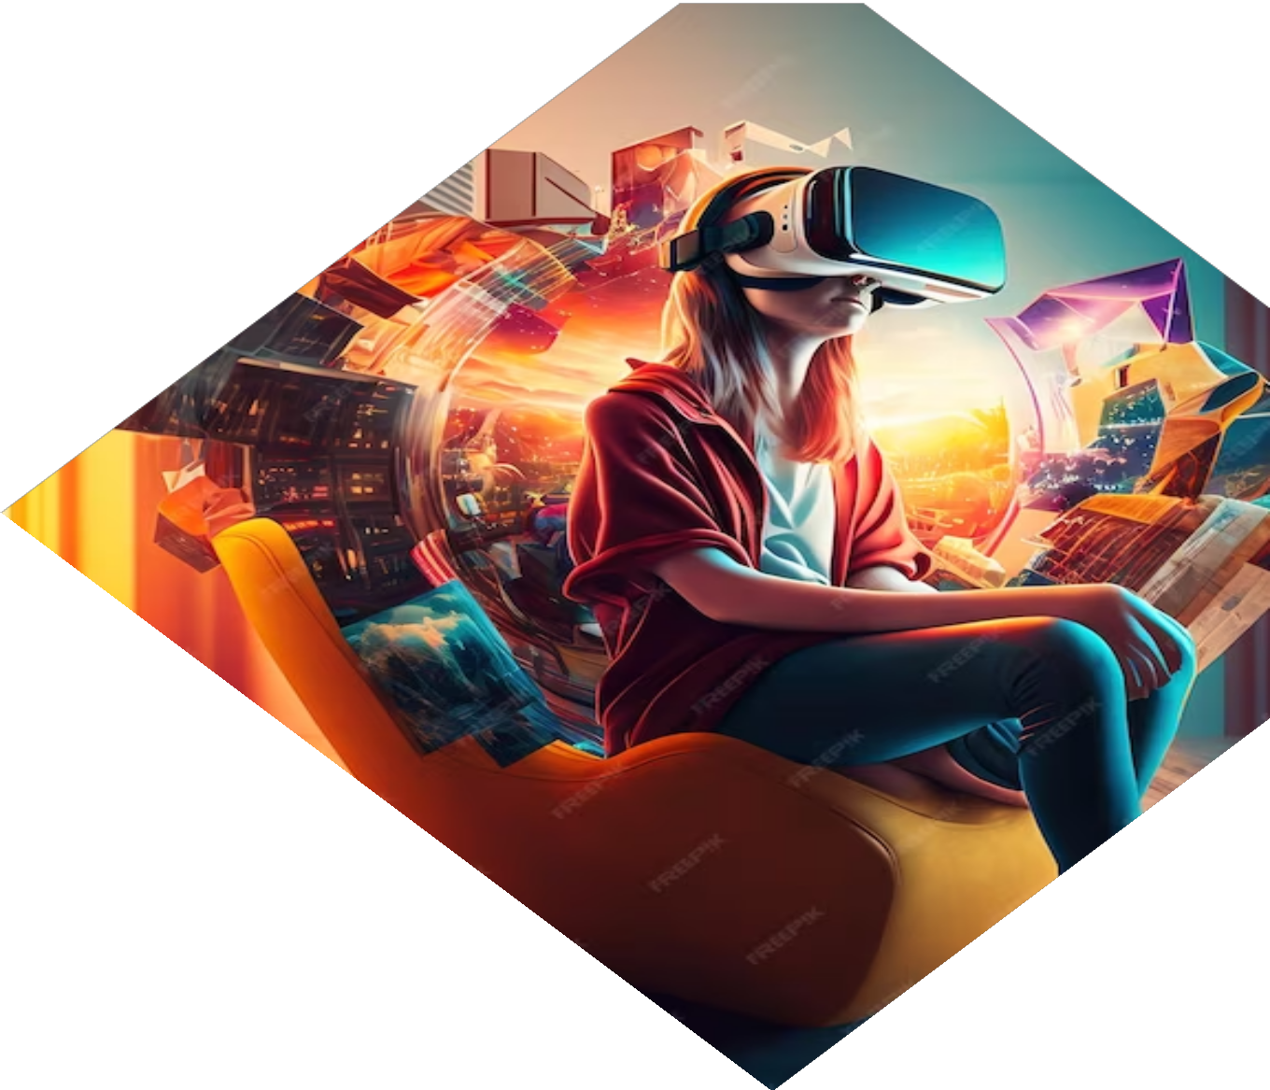
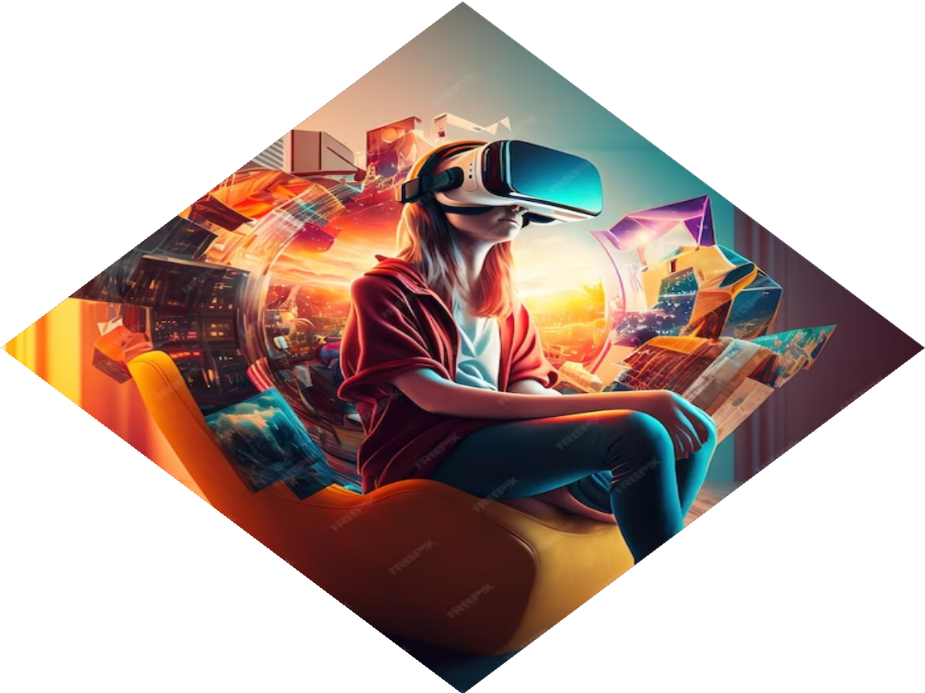
Quiz-App: Unleashing the Full Stack Web Game Phenomenon!
Presentation by SINCHANA POOJARTHY

Slide 2
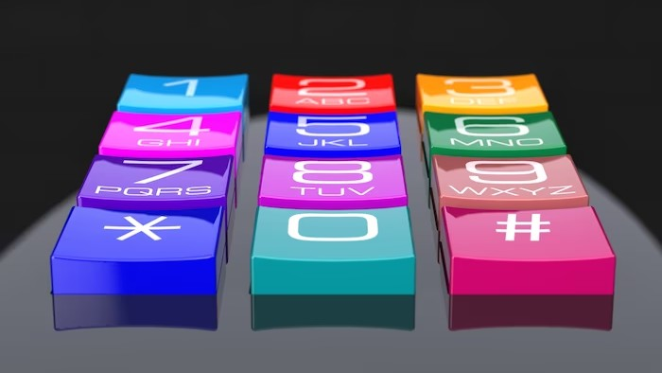



Welcome to Quiz-Zilla!
Get ready to dive into the world of
! In this presentation, we'll explore how Quiz-Zilla
is revolutionizing the gaming industry.
Discover the power of
and the excitement of
. Let's get started!

Slide 3







What is Full Stack Development?
Full Stack Development refers to the ability to develop both the and of a web application. It involves working with
, , , , and more. Full stack developers have a comprehensive understanding of the entire web development process.

Slide 4
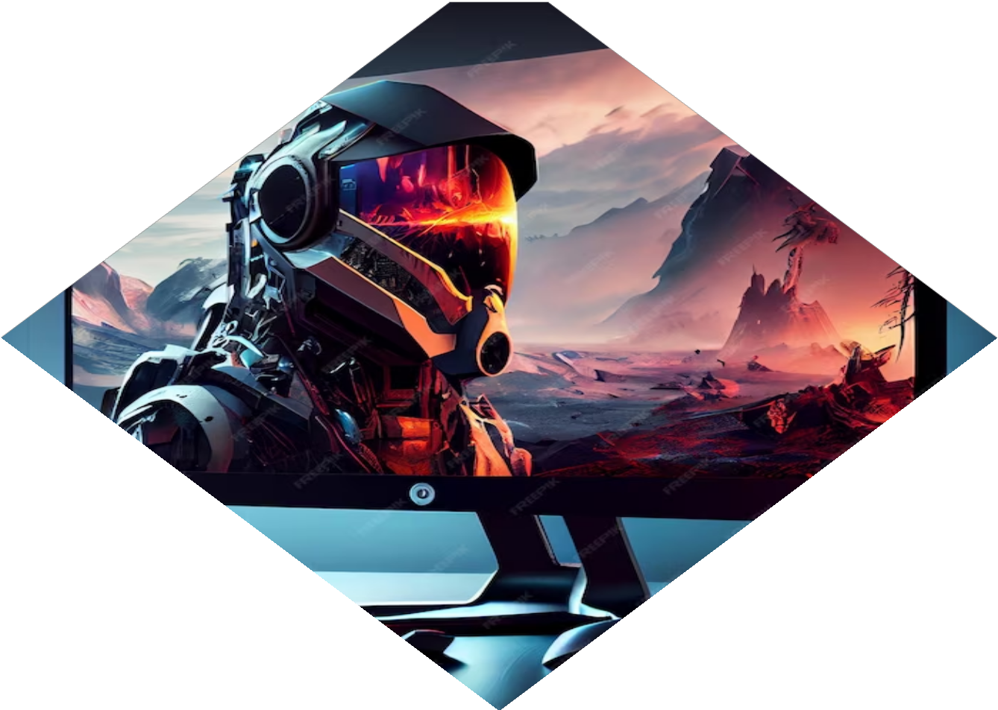


The Rise of Web Games
Web-based games have become incredibly popular in recent years. With advancements in
and , users can now enjoy interactive and immersive gaming experiences directly in their browsers.
This has opened up a whole new world of possibilities for game developers.

Slide 5


Introducing Quiz-Zilla
is a cutting-edge web game that combines the thrill of quizzes with the power of full stack development. It offers a wide range of categories and questions to challenge players. With its intuitive interface and captivating gameplay, Quiz-Zilla is taking the gaming
world by storm!

Slide 6



The Technology Behind Quiz-Zilla
Quiz-Zilla is built using a combination of
, , and for the front- end and fetches questions from external API. This powerful tech stack ensures a seamless gaming experience for players.

Slide 7

Engaging Gameplay Features
Quiz-Zilla offers a range of engaging gameplay features. The game keeps players hooked with its addictive gameplay and exciting features.

Slide 8

Monetization and Expansion
Quiz-App can be made robust by including monetization strategy, power-ups and additional quizzes. The game is constantly expanding its content with regular updates and new quiz categories. With a growing user base and strong revenue streams, Quiz-Zilla is set to dominate the web gaming market.

Slide 9






Benefits of Full Stack Web Games
Full Stack Web Games like Quiz-Zilla offer several beneﬁts, including
, , and
. Players can enjoy the game on any device with a browser, and developers can push updates seamlessly without requiring users to download new versions.

Slide 10
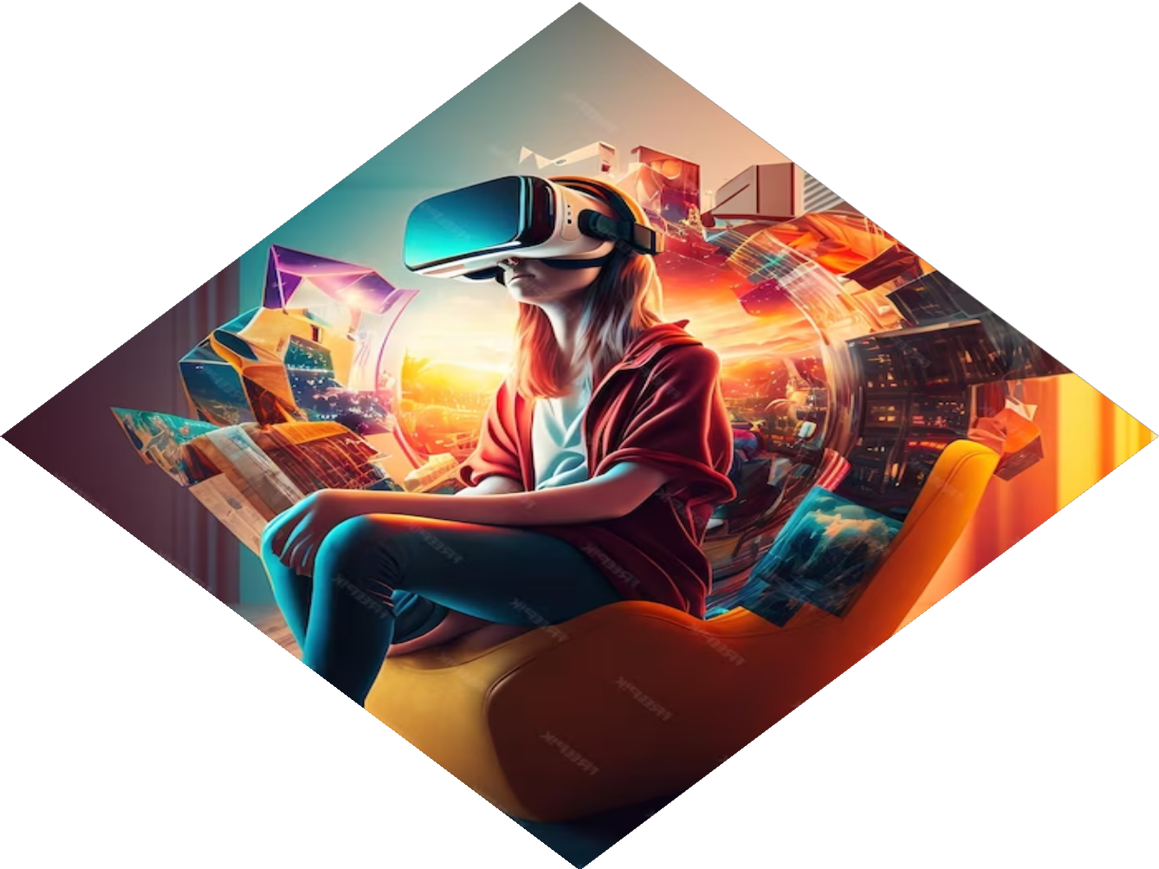




The Future of Web Gaming
The future of web gaming is bright.
With advancements in
and the increasing demand for
, we can expect to see more innovative and immersive web games like Quiz-Zilla. The possibilities are endless, and the gaming industry is ready to embrace the full stack web
game phenomenon!

Slide 11
Thank You!
Thank you for joining us on this exciting journey into the world of Quiz-Zilla and the full stack web game phenomenon. We hope you're inspired to explore the possibilities of web game development. Get ready to unleash your creativity and create the next big web game sensation!

